Slide 1
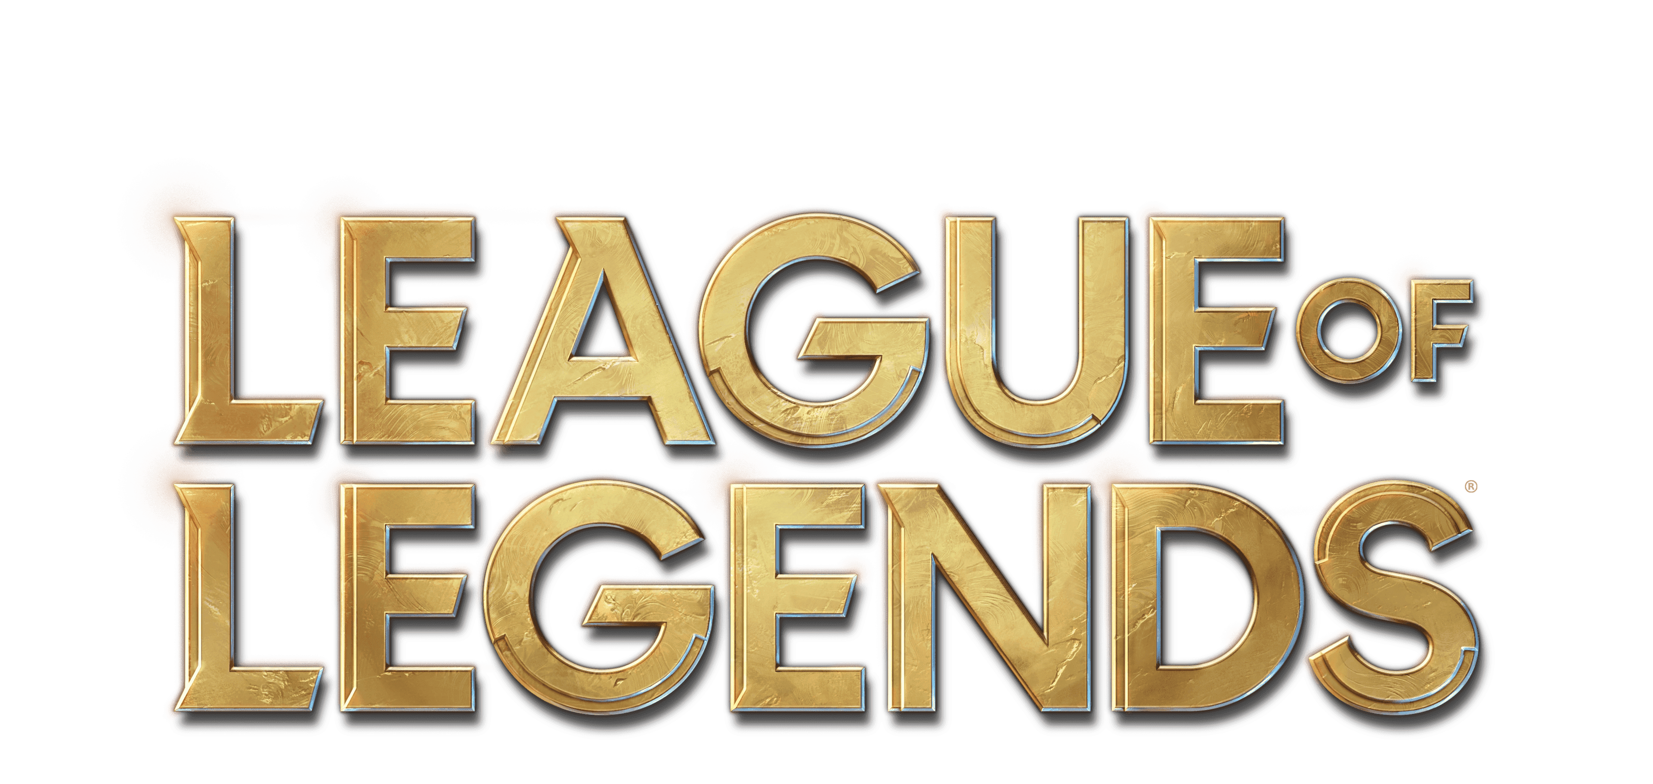
Machine Learning Analysis of Early Game
Johnny Dryman

Slide 2
Goals
Understand importance of first 10 minutes of gameplay using machine learning models
Best model - Logistic Regression with Grid Search CV
Analyze feature imoprtances as determined by best model
Make recommendations to League of Legends development and player experience team

Slide 3
Data
Obtained first 10 minutes of gameplay data from 9,879 matches
Matches were played by Diamond Ranked players (highly skilled)
Contains 19 features per team (38 in total) as well as gameID and ‘blueWins’
Classification models targeted ‘blueWins’ – 0 for a loss and 1 for a victory

Slide 4
Predicting Victory With All Features
Wards Placed
Wards Destroyed
Kills
Assists
Towers Destroyed
Total Gold
Average Level
Total Experience
Total Minions Killed
Total Jungle Minions Killed
Best model: Logistic Regression with Grid Search
Accuracy: 72.1%

Slide 5
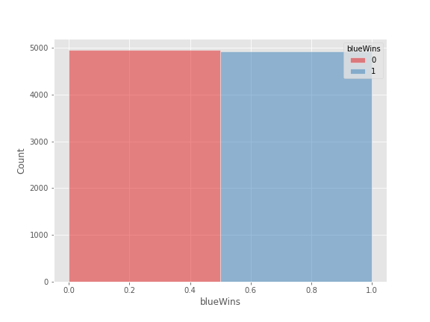
Does Blue or Red have an Advantage?
Total wins:
Blue: 4,949
Red: 4,930
No clear imbalance between teams

Slide 6
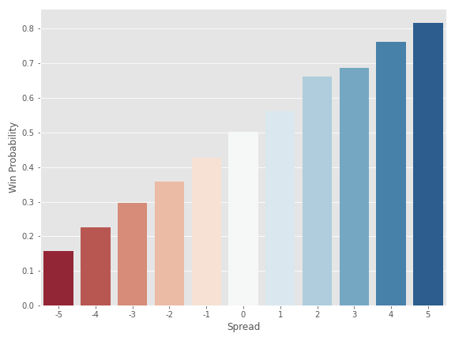
How do kills impact win probability?
As blue’s kill spread at the 10 minute mark grows, so does their probability of winning

Slide 7
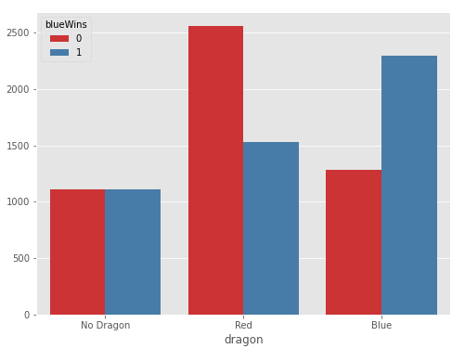
How does defeating the dragon impact victory?
When blue defeats the dragon:
Blue wins = 64%
Red wins = 36%

Slide 8
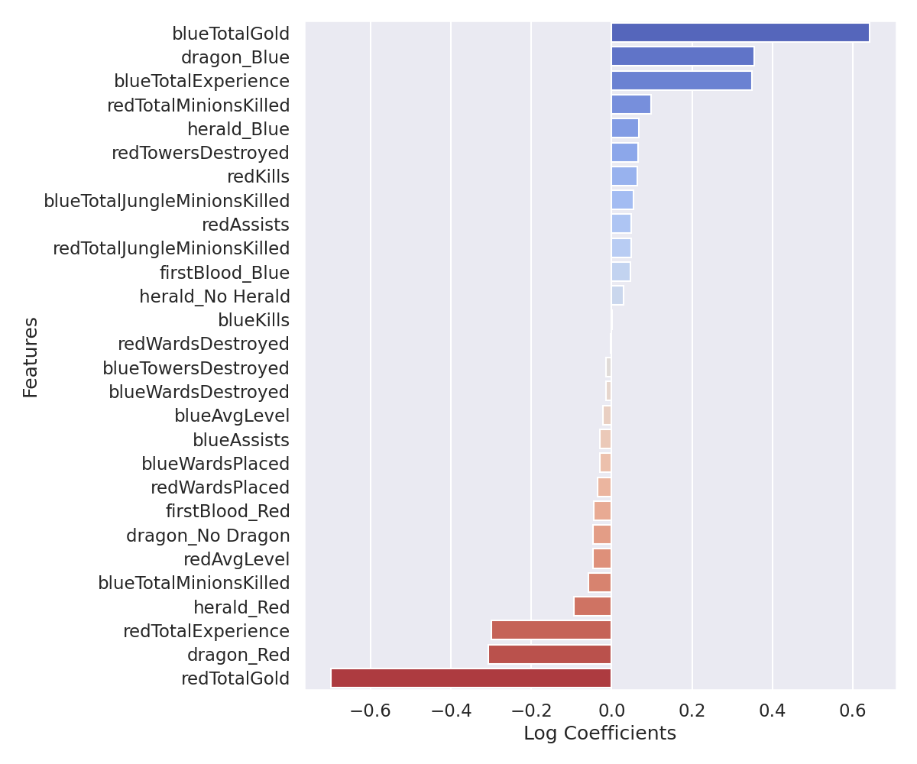
Feature Importance: All Features
Total Gold for both teams has the greatest impact on prediction
Dragon and Total Experience are second
Kills and jungle minions seem undervalued
Model Accuracy: 72.1%

Slide 9
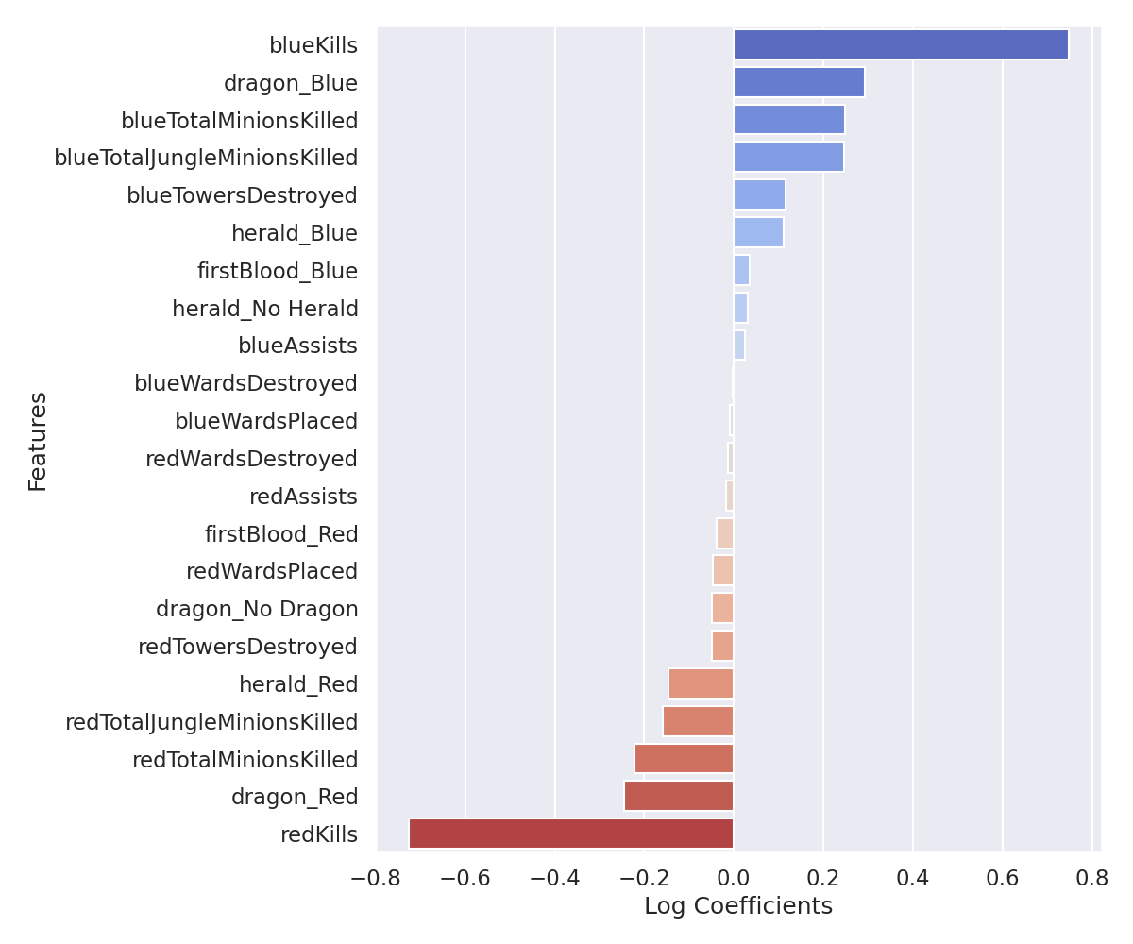
Feature Importance: Player Actions
Kills are most important
Dragon, regular minion and jungle minion kills are all similarly important
Assists, first blood, and wards have little impact
Model accuracy 70.68%

Slide 10
Conclusions
Total Gold is the most important factor in predicting a victory, experience and average level are also important
When only considering player actions, kills is the best predictor of victory. Defeating the dragon and killing minions are also important
Wards placed, wards destroyed, and assists were not significant to our model

Slide 11
Recommendations
Within the first 10 minutes, victory can be predicted with 72% accuracy
Should this be the case? Does sensing defeat this early discourage newer players? Should it be lowered to 2/3 probability or 66%?
To lower predictive quality, consider altering rewards for kills, dragon, and minions
Wards were barely relevant to our model, increasing their significance might add more complexity or variety to gameplay

Slide 12
Next Steps
Expand dataset to include matches between mid-tier and low-tier players
Re-examine same matches from current dataset but at 20 and 30 minute intervals
Does predictive quality improve or stay the same?

Slide 13
Thank you for your time!
Please feel free to ask any questions

